Slide 1
Student Performance Dataset
19BCE259 - Smit Shah
19BCE266 - Jainil Sokhadia

Slide 2
Data Pre processing
Both datasets are processed to check
1. Null Values
2. Duplicates
But fortunately there are no such irregularities in the dataset,implying that data is already clean and processed.
Since both datasets have same set of attributes and has similar kind of data ,the both datasets are merged vertically ,so as to make the dataset effective and increase the dataset
This process is supposedly key aspect of data preprocessing.
Dataset - Student dataset

Slide 3
Data Visualization
After having our dataset processed, we move to the next step which is dataset visualization; so that patterns, trends and correlations that might not otherwise be detected can be now exposed.
This discipline will give us some insights into our data and help us understand the dataset by placing it in a visual context using python libraries such as: matplotlib and seaborn.

Slide 4
Modification of dataset
A new column called ‘FinalGrade’ is asserted which reflects ‘Grade 3’ and a broader level view of ‘Grade3’.
The column is inferred broadly as five categories under given conditions as follows:
● 'A' - [(data.G3 >= 18) & (data.G3 <= 20)]
● 'B' - [(data.G3 >= 15) & (data.G3 <= 17)]
● 'C' - [(data.G3 >= 11) & (data.G3 <= 14)]
● 'D' - [(data.G3 >= 6) & (data.G3 <= 10)]
● 'F' - [(data.G3 >= 0) & (data.G3 <= 5)]

Slide 5
Data visualization for different attributes
Age Group
School
Address
Reason
Study time
Travel Time
Free Time
Extra Curricular
Guardian
Family Education support
School Education Support
Past class failure
Extra classes
Interested in higher education
In a romantic relationship
Quality of family relationship
Going out with friends
Weekday Alcohol Consumption
Weekend Alcohol Consumption

Slide 6
Grade Analysis for different Attributes
If a student is older than 20 years, he/she can't get good grades.
Female students have slightly better performance in school than the male students
GP school students are smarter than MS school students
Urban area students have greater grades
Students who have their guardians other than their parents get less grades
Having bad family relationship affects student's grade negatively
Students who are in a Romantic relationship have an adverse effect on their studies and get less grades
Students who study more than 10 hours get good grades.
Students who have more travel time for school, get badly affected in grades.

Slide 7
Grade Analysis for different Attributes
Parent's status of living together or apart does not affect the grades
Students who are engaged in extracurricular activities do not have any inverse effect on grades.
Less alcohol consumption leads to good grades.
Students who hang out with friends have not affected their performance much, but the students who hang out very frequently, tend to get less grades.
Students who fail often have a very slim chance of getting good grades.
Family education support does not play an important role in student's grades
Even after getting educational support from school, students can't get good grades.
Students who remain absent either get very good grades or very bad grades.

Slide 8
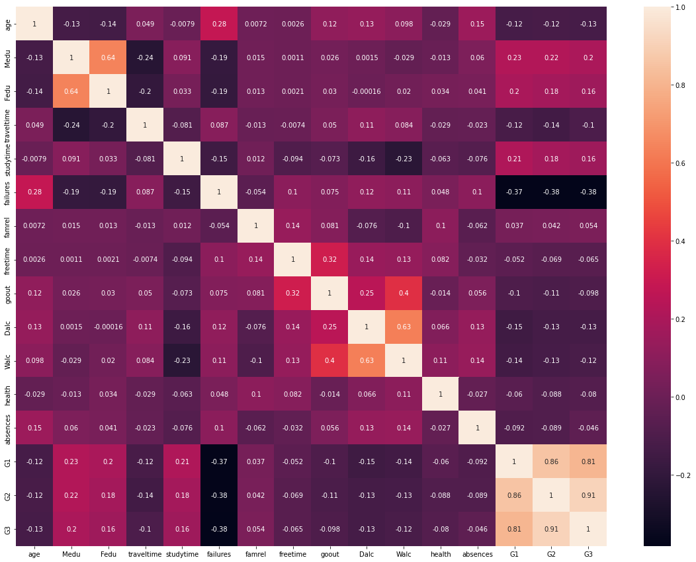
Correlation Map

Slide 9
ML Models
Decision Tree
SVC
Logistic Regression

Slide 10
Decision Tree
The Decision Tree is a prediction algorithm used both for regression and classification, in our case we will use it for the latter. In the construction of a Decision Tree we divide the space where the samples reside in various regions, these splits are made on the value of a predictor for each split
We continue to make splits until the leaves (terminal nodes) have less than a minimum number of samples decided a priori. Then when a new sample arrives to assign a class you follow the split rules and once assigned to a given leaf you give it the most common label inside it.
Observing our table we can see that the Decision Tree obtains slightly worse results than the logistic regression in terms of total accuracy.
The following table instead shows the features related to their importance compared to the classification, underlining once again how failures is the parameter that influences the choice the most.

Slide 11
SVC Model
In machine learning, support-vector machines are supervised learning models with associated learning algorithms that analyze data for classification and regression analysis.
SVC model allows to find the hyperplane that separates the points of our dataset in the two classes we decided, not only separating them but with the maximum possible margin. The points that reside on the margin are called support vector and are the only ones that influence the choice of decision boundaries.

Slide 12
Logistic Regression
When we are in the presence of a binary classification an easily usable classification model is the Logistic Regression, which does not directly model the answer, but the probability that the answer belongs to a certain category. To achieve this and create the model, we therefore use the logistic function

Slide 13
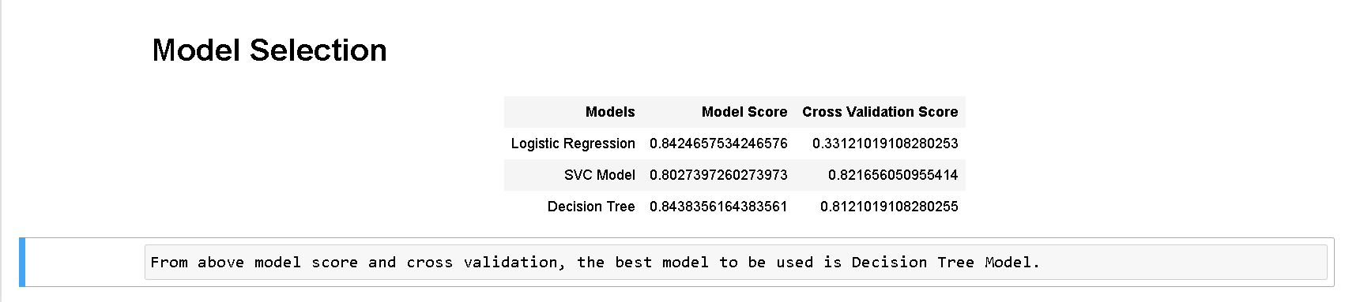
Conclusion

Slide 14
Thank you

